Slide 1
Delay
Song Chen
Nov. 12, 2015
http://staff.ustc.edu.cn/~songch/da-ug.htm

Slide 2
Outline
Delay
  Gate
  Wire (Interconnect)

Slide 3
Timing Optimization
Architecture/Micro-architecture
  Pipeline stages, number of execution units (parallelism), size of memories
    Selected Algorithms, Technology, Memory access speed, Wire delay
Logic level
  Types of functional blocks (e.g., ripple carry vs. look-ahead adders), number of gate stages in the clock cycle, fan-in/fan-out of the gates
Circuit-level
  Transistor sizes, CMOS logic styles
Layout-level
  Floorplan, cell layouts, routing, etc.

Slide 4
Common Design Practice
To write RTL code, Simulate
Synthesize to check if the results are fast enough
  Timing optimization at Logic, circuit, placement level.
  If not: recode the RTL with more parallelism or pipelining, or changes the algorithm and repeats until the timing constraints are satisfied.
  Timing analyzers are used to check the Timing closure.
  Without an understanding of the lower levels of abstraction where the synthesizer is working, a designer may have a difficult time achieving timing closure on a challenging system.

Slide 5
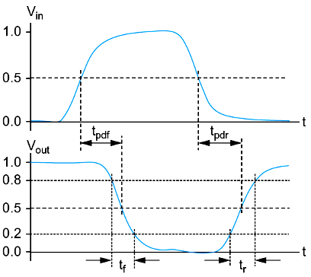
Delay Definitions
t_{pdr}/t_{pdf}: rising/falling propagation (maximum) delay
  From input to rising/falling output crossing V_{DD}/2
t_{cdr}/t_{cdf}: rising/falling contamination (minimum) delay
  From input to falling output crossing V_{DD}/2
t_{pd}/t_{cd}: average propagation delay
  t_{pd} = (t_{pdr} + t_{pdf})/2
t_{r}: rise time
  From output crossing 0.2 V_{DD} to 0.8 V_{DD}
t_{f}: fall time
  From output crossing 0.8 V_{DD} to 0.2 V_{DD}

Slide 6
Delay Estimation
We would like to be able to easily estimate delay
  Not as accurate as simulation
  But easier to ask “What if?”
Use RC delay models to estimate delay
  C = total capacitance on output node
  Use effective resistance R
  So that t_{pd} = RC
Characterize transistors by finding their effective R
  Depends on average current as gate switches

Slide 7
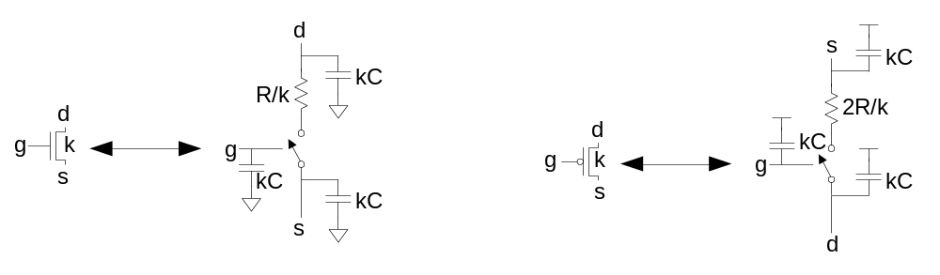
RC Delay Model
Use equivalent circuits for MOS transistors
  Ideal switch + capacitance and ON resistance
  Unit nMOS has resistance R, capacitance C
  Unit pMOS has resistance 2R, capacitance C
Capacitance proportional to width
Resistance inversely proportional to width

Slide 8
RC Values
Capacitance
  C = C_{g} = C_{s} = C_{d} = 2 fF/μm of gate width in 0.6 μm
  Gradually decline to 1 fF/μm in nanometer techs.
Resistance
  R ≈ 6 KΩ*μm in 0.6 μm process
  Improves with shorter channel lengths
Unit transistors
  May refer to minimum contacted device (4/2 λ)
  Or maybe 1 μm wide device
  Doesn’t matter as long as you are consistent

Slide 9
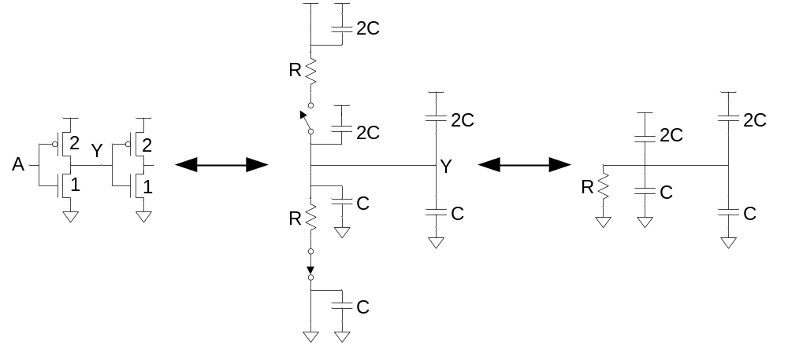
Inverter Delay Estimate
Estimate the delay of a fanout-of-1 inverter
d = 6RC

Slide 10
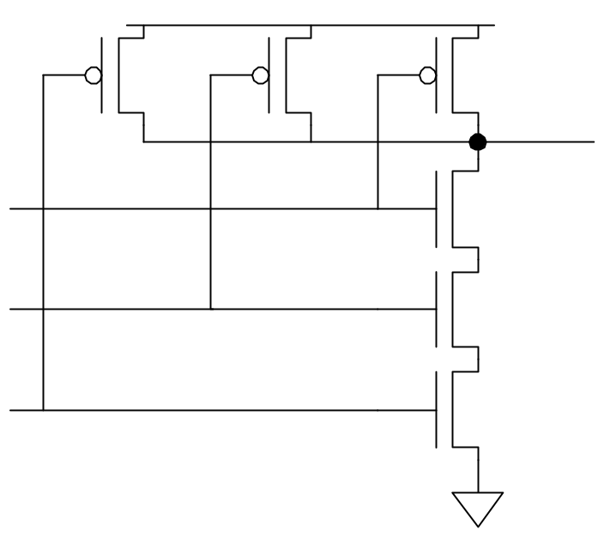
Example: 3-input NAND
Sketch a 3-input NAND with transistor widths chosen to achieve effective rise and fall resistances equal to a unit inverter (R).
2
2
2
3
3
3

Slide 11
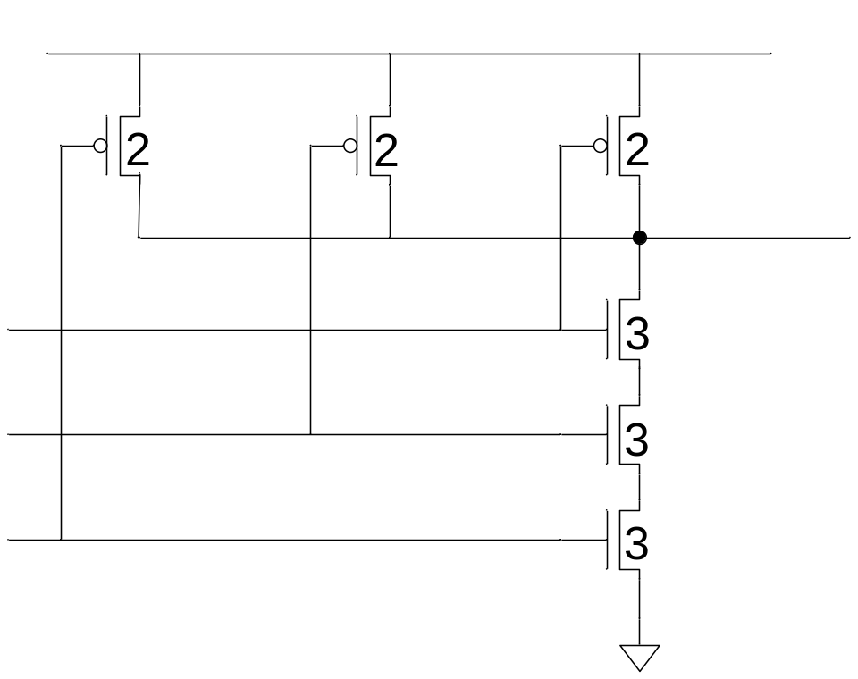
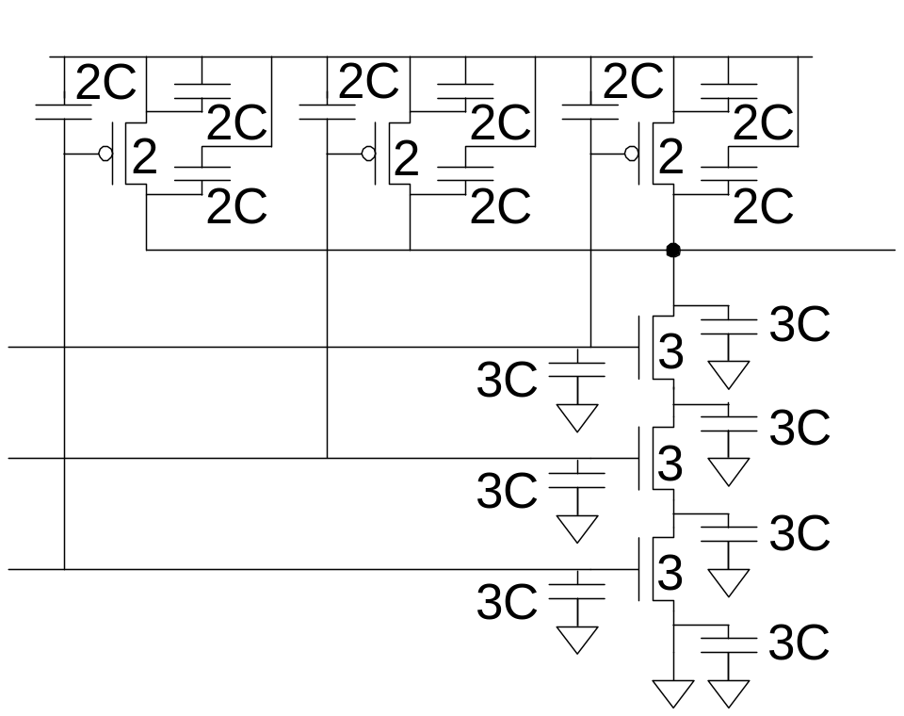
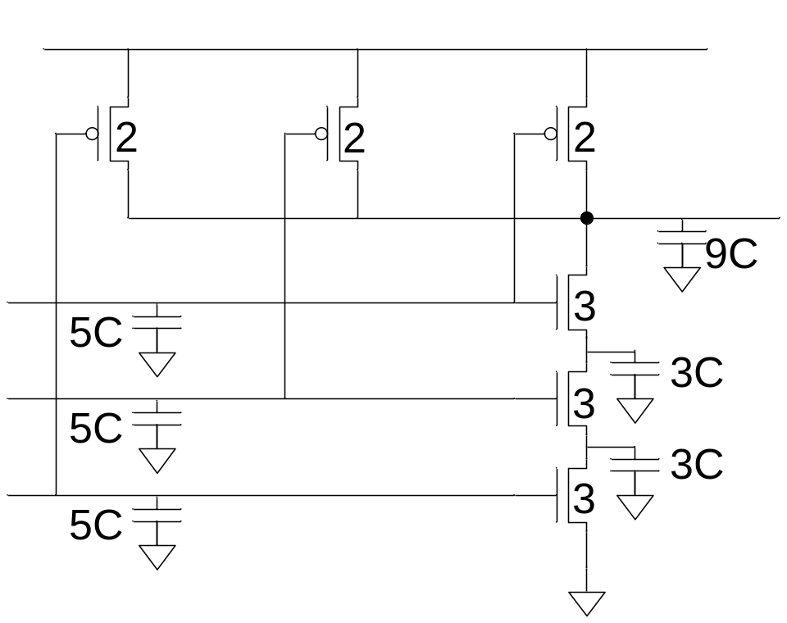
3-input NAND Caps
Annotate the 3-input NAND gate with gate and diffusion capacitance.

Slide 12
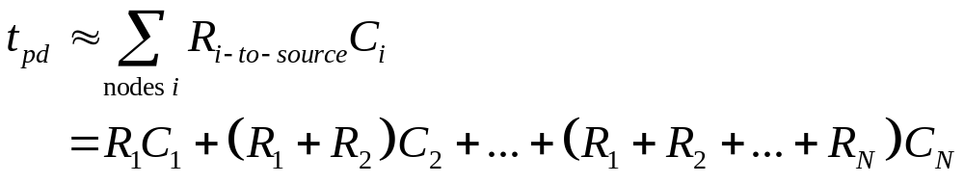
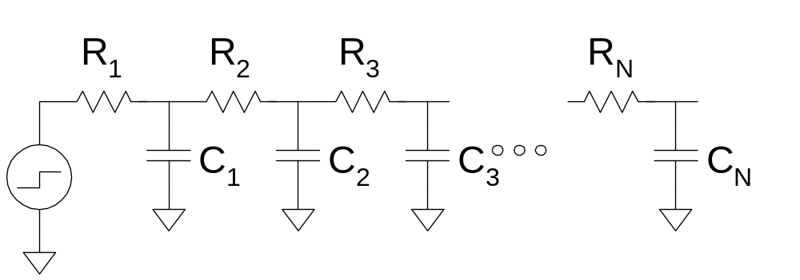
Elmore Delay
ON transistors look like resistors
Pullup or pulldown network modeled as RC ladder
Elmore delay of RC ladder

Slide 13
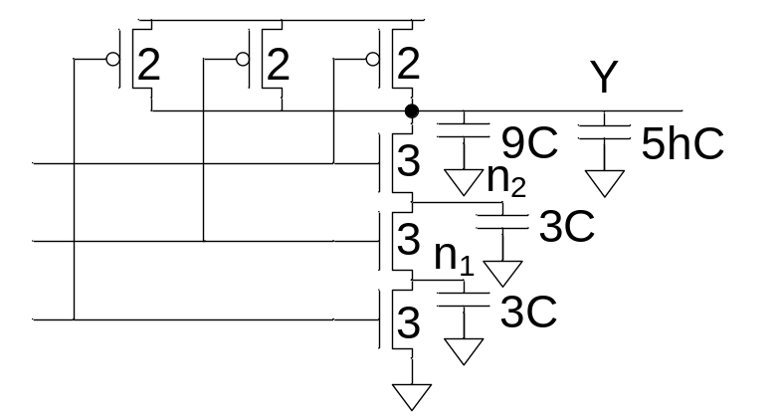
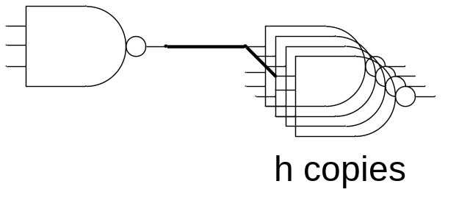
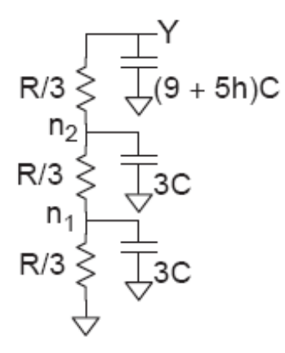
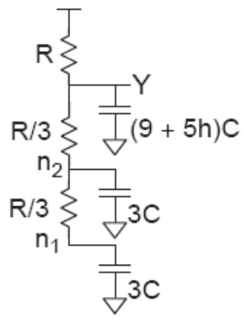

Example: 3-input NAND
Estimate worst-case rising and falling delay of 3-input NAND driving h identical gates.

Slide 14
Delay Components
Delay has two parts
  Parasitic delay
    9 or 11 RC
    Independent of load
  Effort delay
    5h RC
    Proportional to load capacitance

Slide 15
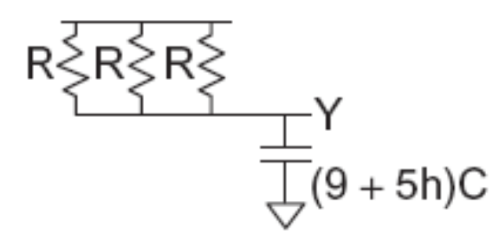
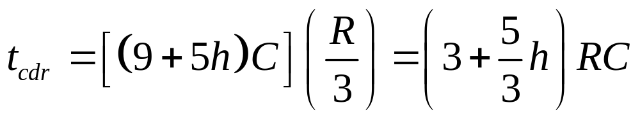
Contamination Delay
Best-case (contamination) delay can be substantially less than propagation delay.
Ex: If all three inputs fall simultaneously

Slide 16
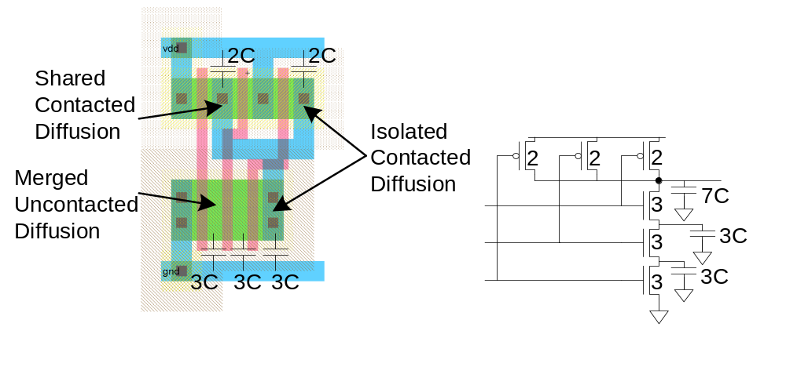
Diffusion Capacitance
We assumed contacted diffusion on every s / d.
Good layout minimizes diffusion area
Ex: NAND3 layout shares one diffusion contact
  Reduces output capacitance by 2C
  Merged uncontacted diffusion might help too

Slide 17
Timing Analysis Delay Models
Slope-Based Linear Model
  delay_rise = intrinsic_rise + rise_resistance x capacitance + slope_rise x delay_previous
  delay_fall = intrinsic_fall + fall_resistance x capacitance + slope_fall x delay_previous
Nonlinear Delay Model: Two-dimensional interpolation
  Look up the delay from a table based on the load capacitance and the input slope
Current Source Model
  Express the output DC current as a nonlinear function of the input and output voltages of the cell
  Analyzer numerically integrates the output current to find the voltage as a function of time into an arbitrary RC network and to solve for the propagation delay.

Slide 18
Wire/Interconnect
Introduction
Interconnect Modeling
  Wire Resistance
  Wire Capacitance
Wire RC Delay
Crosstalk
Wire Engineering
Repeaters

Slide 19
Introduction
Chips are mostly made of wires called interconnect
  Transistors are little things under the wires
  Many layers of wires
Wires are as important as transistors
  Speed
  Power
  Noise
Alternating layers run orthogonally

Slide 20
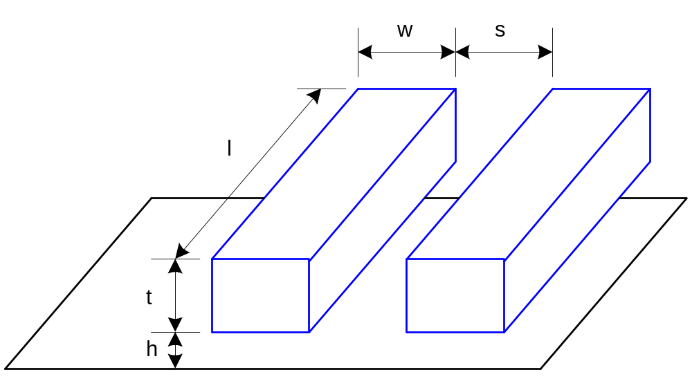
Wire Geometry
Pitch = w + s
Aspect ratio: AR = t/w
  Old processes had AR << 1
  Modern processes have AR ≈ 2
    Pack in many skinny wires

Slide 21
Layer Stack
AMI 0.6 μm process has 3 metal layers
  M1 for within-cell routing
  M2 for vertical routing between cells
  M3 for horizontal routing between cells
Modern processes use 6-10+ metal layers
  M1: thin, narrow (< 3λ)
    High density cells
  Mid layers
    Thicker and wider, (density vs. speed)
  Top layers: thickest
    For V_{DD}, GND, clk

Slide 22
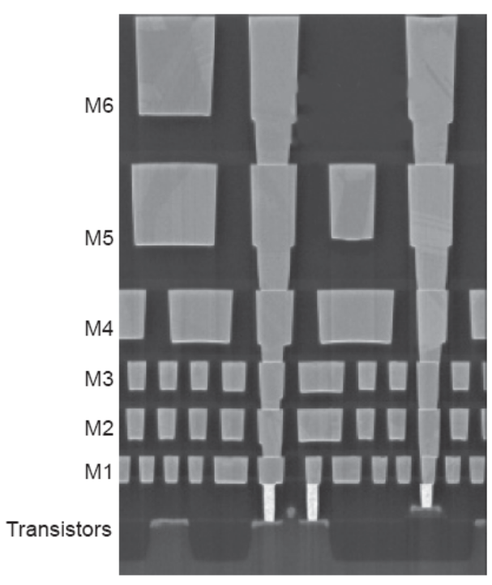
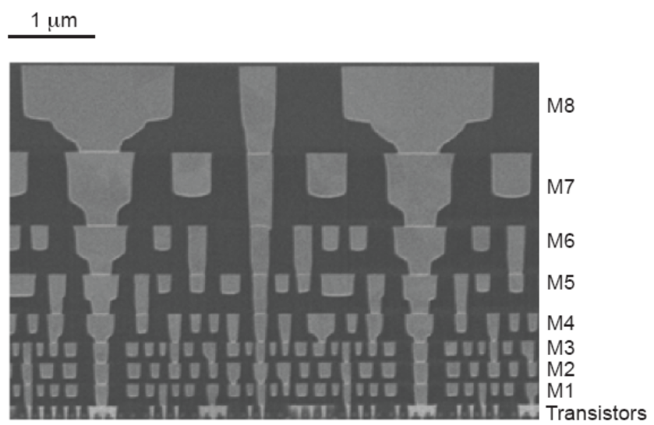
Example
Intel 90 nm Stack
Intel 45 nm Stack
[Thompson02]
[Moon08]

Slide 23
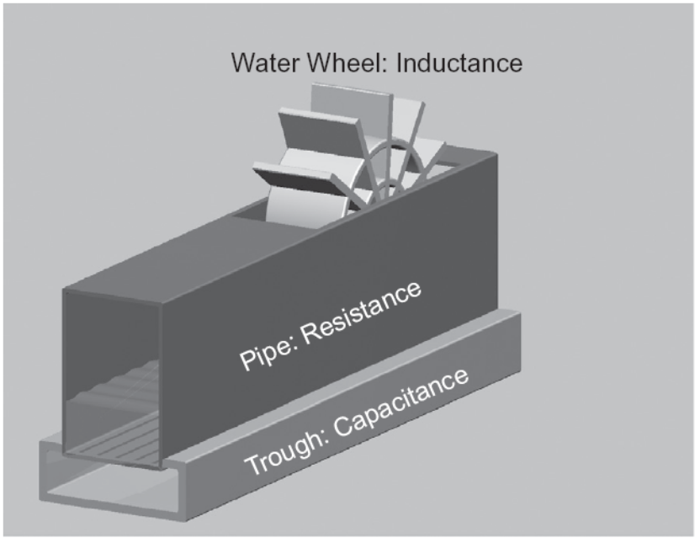
Interconnect Modeling
Current in a wire is analogous to current in a pipe
  Resistance: narrow size impedes flow
  Capacitance: trough under the leaky pipe must fill first
  Inductance: paddle wheel inertia opposes changes in flow rate
    Negligible for most
    wires

Slide 24
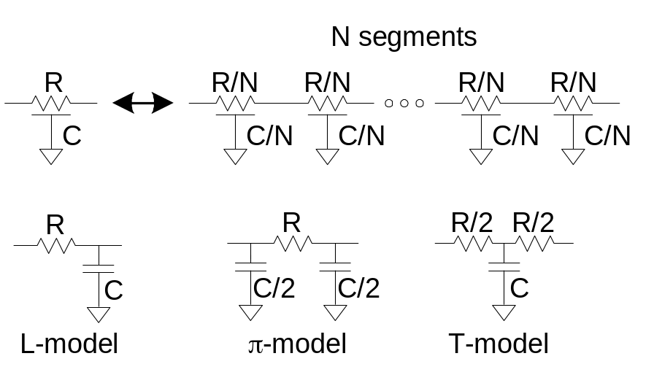
Lumped Element Models
Wires are a distributed system
  Approximate with lumped element models
3-segment π-model is accurate to 3% in simulation
L-model needs 100 segments for same accuracy!
Use single segment π-model for Elmore delay

Slide 25
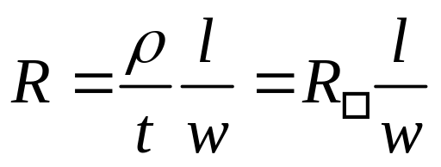
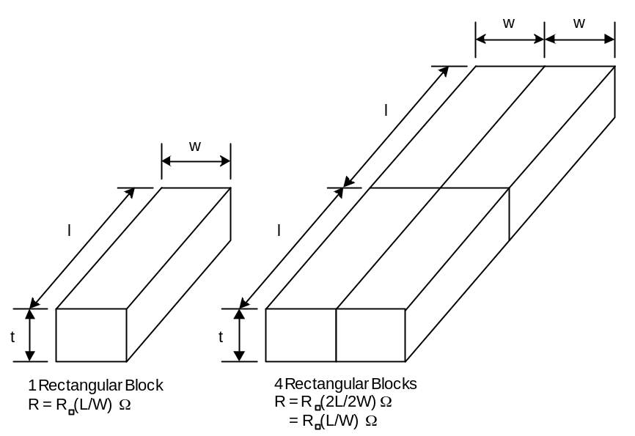
Wire Resistance
ρ = resistivity (Ω*m)
R□ = sheet resistance (Ω/□)
  □ is a dimensionless unit(!)
Count number of squares
  R = R□ * (# of squares)

Slide 26
Choice of Metals
Until 180 nm generation, most wires were aluminum
Contemporary processes normally use copper
  Cu atoms diffuse into silicon and damage FETs
  Must be surrounded by a diffusion barrier
Metal | Bulk resistivity (μΩ • cm)
Silver (Ag) | 1.6
Copper (Cu) | 1.7
Gold (Au) | 2.2
Aluminum (Al) | 2.8
Tungsten (W) | 5.3
Titanium (Ti) | 43.0

Slide 27
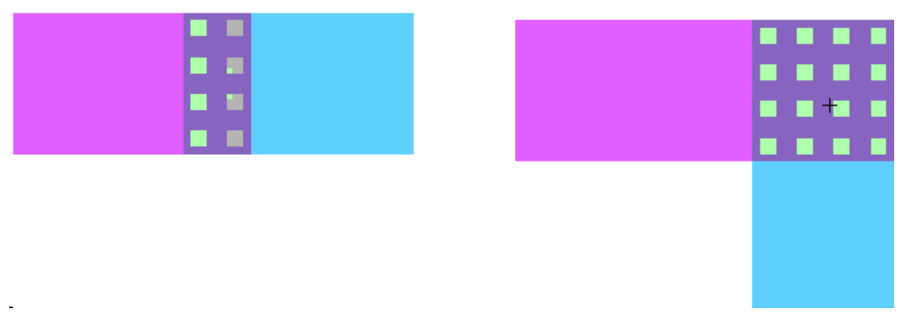
Contacts Resistance
Contacts and vias also have 2-20 Ω
  Depending on the contacted materials and size of the contact
Use many contacts for lower R
  Many small contacts for current crowding around periphery

Slide 28
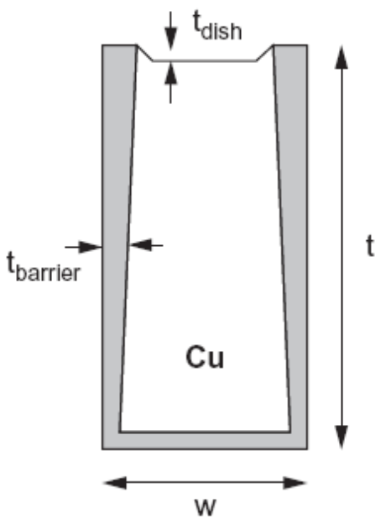
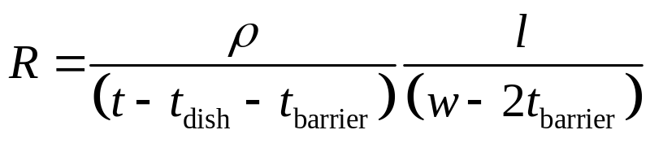
Copper Issues
Copper wires diffusion barrier has high resistance
Copper is also prone to dishing during polishing
Effective resistance is higher

Slide 29
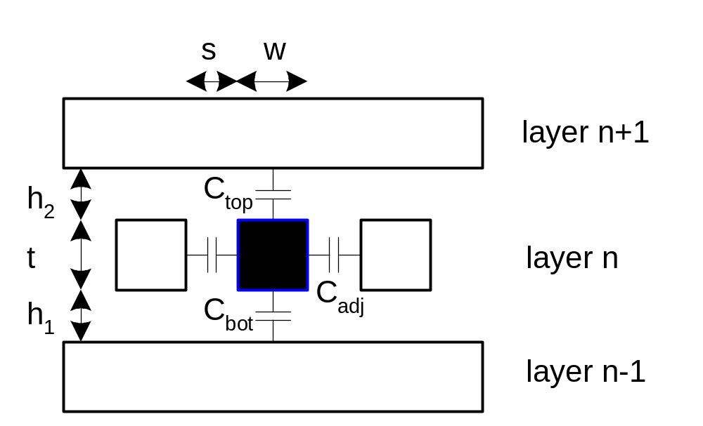
Wire Capacitance
Wire has capacitance per unit length
  To neighbors
  To layers above and below
C_{total} = C_{top} + C_{bot} + 2C_{adj}

Slide 30
Capacitance Trends
Parallel plate equation: C = ε_{ox}A/d
  Wires are not parallel plates, but obey trends
  Increasing area (w, t) increases capacitance
  Increasing distance (s, h) decreases capacitance
Dielectric constant
  ε_{ox} = kε₀
    ε₀ = 8.85 x 10⁻¹⁴ F/cm
    k = 3.9 for SiO₂
Processes are starting to use low-k dielectrics
  k ≈ 3 (or less) as dielectrics use air pockets

Slide 31
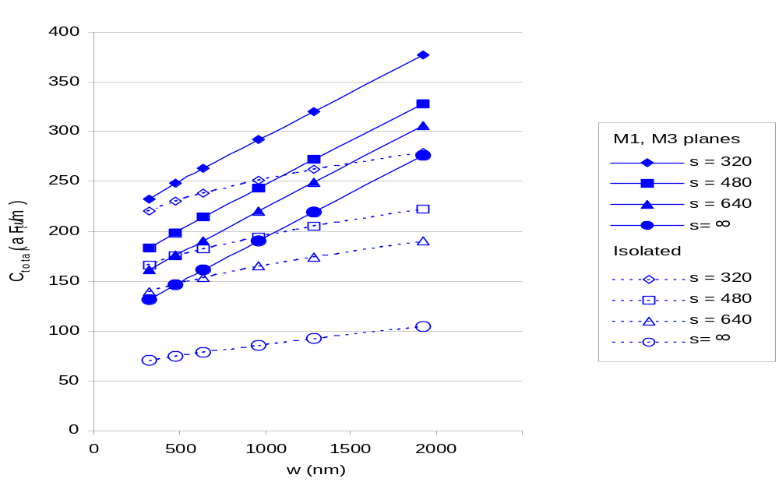
M2 Capacitance Data
Typical dense wires have ~ 0.2 fF/μm
  Compare to 1-2 fF/μm for gate capacitance
Capacitance of metal2 (180nm) line as a function of width and spacing

Slide 32
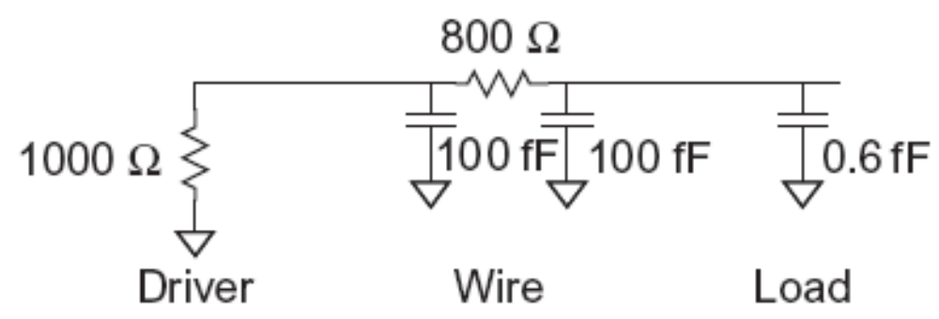
Wire RC Delay
Estimate the delay of a 10x inverter driving a 2x inverter at the end of the 1 mm wire. Assume wire capacitance is 0.2 fF/μm and that a unit-sized nMOS transistor has R = 10 KΩ and C = 0.1 fF.
  t_{pd} = (1000 Ω)(100 fF) + (1000 + 800 Ω)(100 + 0.6 fF) = 281 ps

Slide 33
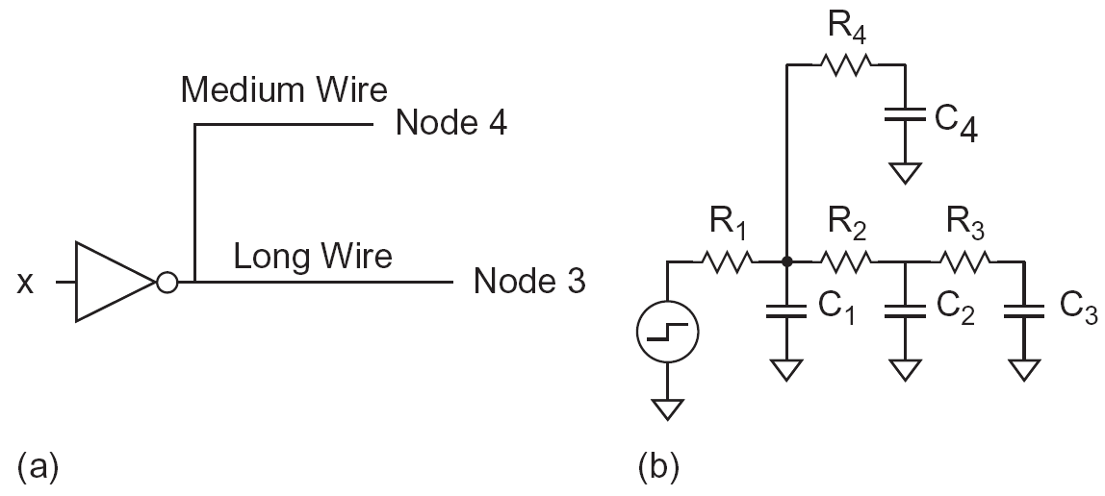
Interconnect Modeling with RC tree (Elmore Delay)

Slide 34
Crosstalk
A capacitor does not like to change its voltage instantaneously.
A wire has high capacitance to its neighbor.
  When the neighbor switches from 1-> 0 or 0->1, the wire tends to switch too.
  Called capacitive coupling or crosstalk.
Crosstalk effects
  Noise on nonswitching wires
  Increased delay on switching wires

Slide 35
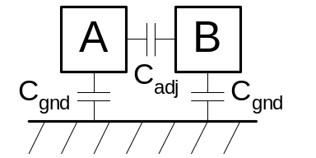
Crosstalk Delay
Assume layers above and below on average are quiet
  Second terminal of capacitor can be ignored
  Model as C_{gnd} = C_{top} + C_{bot}
A Switches: Effective C_{adj} depends on behavior of neighbors
  Miller effect
B | ΔV | C_{eff(A)} | MCF
Constant | V_{DD} | C_{gnd} + C_{adj} | 1
Switching with A | 0 | C_{gnd} | 0
Switching opposite A | 2V_{DD} | C_{gnd} + 2 C_{adj} | 2

Slide 36
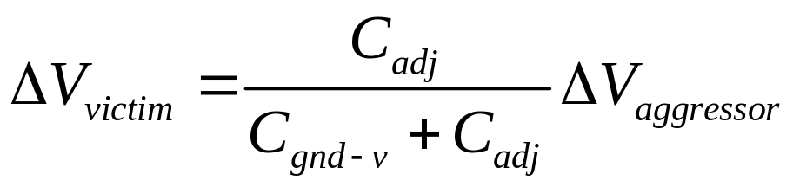
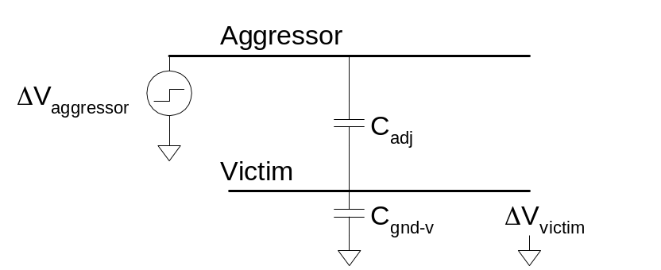
Crosstalk Noise
Crosstalk causes noise on non-switching wires
If victim is floating:
  model as capacitive voltage divider

Slide 37
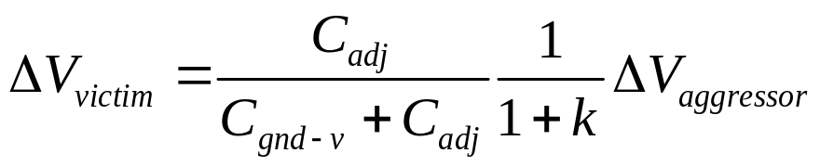
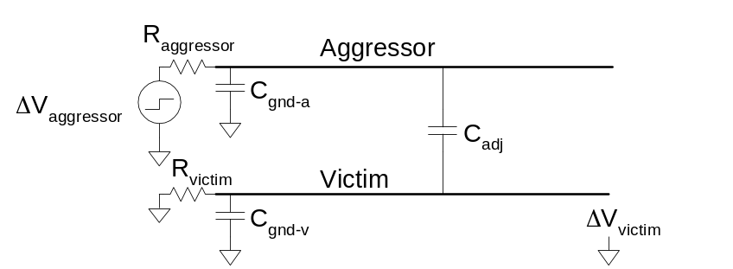
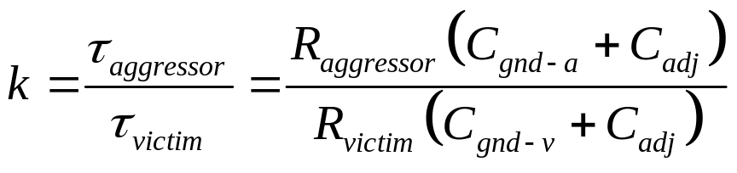
Driven Victims
Usually victim is driven by a gate that fights noise
  Noise depends on relative resistances
  Victim driver is in linear region, agg. in saturation
  If sizes are same, R_{aggressor} = 2-4 x R_{victim}

Slide 38
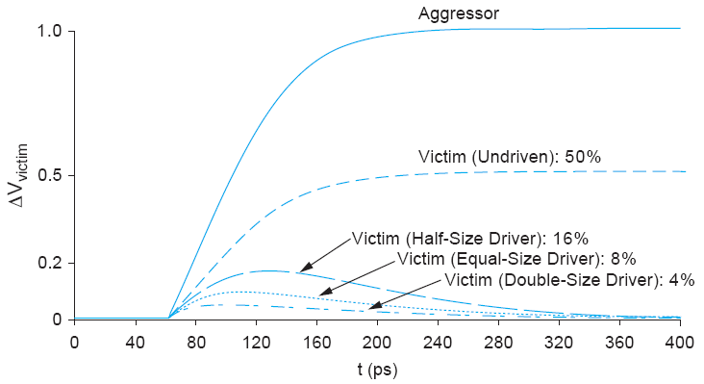
Coupling Waveforms
Simulated coupling for C_{adj} = C_{victim}

Slide 39
Noise Implications
So what if we have noise?
If the noise is less than the noise margin, nothing happens
Static CMOS logic will eventually settle to correct output even if disturbed by large noise spikes
  But glitches cause extra delay
  Also cause extra power from false transitions
Memories and other sensitive circuits also can produce the wrong answer

Slide 40
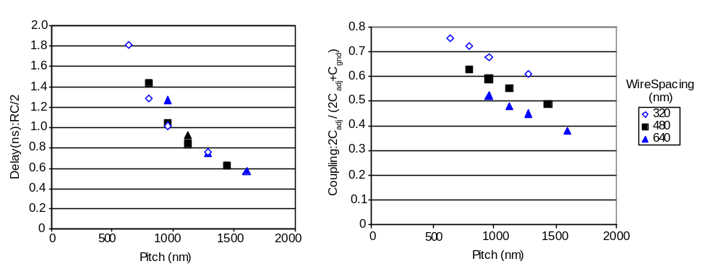
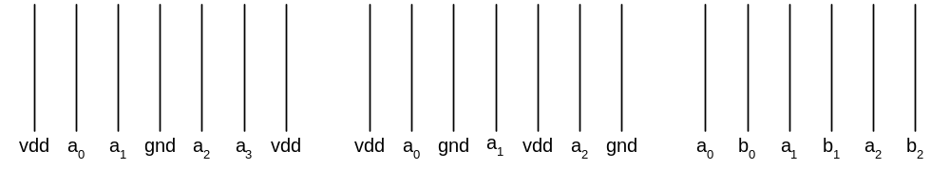
Wire Engineering
Goal: achieve delay, area, power goals with acceptable noise
Degrees of freedom:
  Width
  Spacing
  Layer
  Shielding

Slide 41
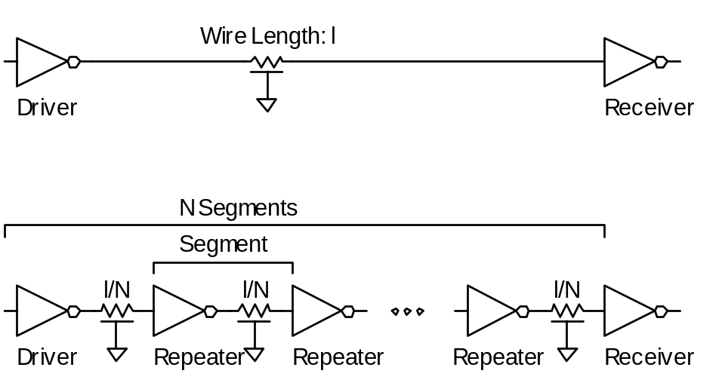
Repeaters
R and C are proportional to l
RC delay is proportional to l²
  Unacceptably great for long wires
Break long wires into N shorter segments
  Drive each one with an inverter or buffer

Slide 42
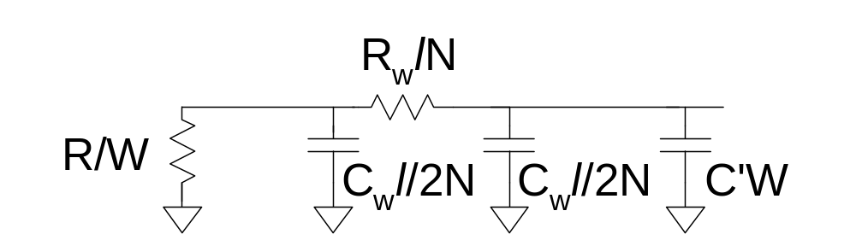
Repeater Design
How many repeaters should we use?
How large should each one be?
Equivalent Circuit
  Wire length l/N
    Wire Capacitance C_{w}*l/N, Resistance R_{w}*l/N
  Inverter width W (nMOS = W, pMOS = 2W)
    Gate Capacitance C’*W, Resistance R/W

Slide 43

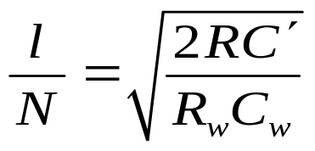
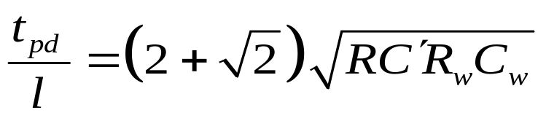
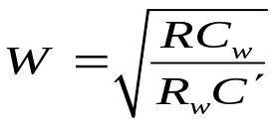
Repeater Results
Write equation for Elmore Delay
  Differentiate with respect to W and N
  Set equal to 0, solve
~40 ps/mm
in 65 nm process

Slide 44
Repeater Energy
Energy / length ≈ 1.87C_{w}V_{DD}²
  87% premium over unrepeated wires
  The extra power is consumed in the large repeaters
If the repeaters are downsized for minimum EDP:
  Energy premium is only 30%
  Delay increases by 14% from min delay

Slide 45
Reference
Reference [4]. Chapter 4.3, Chapter 6

